Slide 1
Big Data
Hadoop Basics
LEVEL – PRACTITIONER

Slide 2
Sudarshan Shetty
Manager-Big Data / 10 Years
1.0

Slide 3









Icons Used
Hands on Exercise
Questions
Tools
Coding Standards
Test Your Understanding
Case Study
Best Practices & Industry Standards
Demonstration
Workshop

Slide 4
Overview
This chapter will cover the concepts of Hadoop and the Hadoop distributed file system in detail.

Slide 5
Objectives
After completing this chapter you will be able to:
Describe what is Hadoop
Describe Hadoop components
Describe Hadoop characteristics
Describe Hadoop building blocks
Describe HDFS components
Explain the read and write operations in Hadoop
Setup a single node and multinode Hadoop cluster
Describe various failure modes and recovery steps
Describe various usage patterns in Hadoop
Describe where Hadoop can not be used

Slide 6

What is Hadoop
Hadoop is a high-performance distributed data storage and processing system. Its two major subsystems are :
HDFS for storage
Mapreduce for parallel data processing.
It can store any kind of data from any source, inexpensively and at very large scale, and it can do very sophisticated analysis of that data easily and quickly.
Hadoop automatically detects and recovers from hardware, software and system failures.
Hadoop provides scalable, reliable and fault tolerant services for data storage and analysis at very low cost.

Slide 7
Hadoop Components
Hadoop Distributed File System, or HDFS
HDFS is the storage system for a Hadoop cluster. When data arrives at the cluster, the HDFS software breaks it into pieces and distributes those pieces among the different servers participating in the cluster. Each server stores just a small fragment of the complete data set, and each piece of data is replicated on more than one server.
Distributed data processing framework called MapReduce
Because Hadoop stores the entire dataset in small pieces across a collection of servers, analytical jobs can be distributed, in parallel, to each of the servers storing part of the data. Each server evaluates the question against its local fragment simultaneously and reports its results back for collation into a comprehensive answer. MapReduce is the plumbing that distributes the work and collects the results

Slide 8
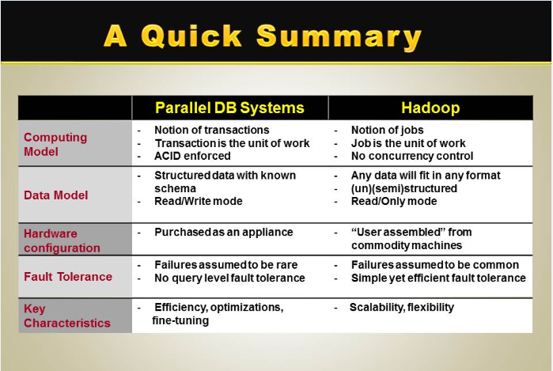
Hadoop Vs. Parallel DB Systems

Slide 9
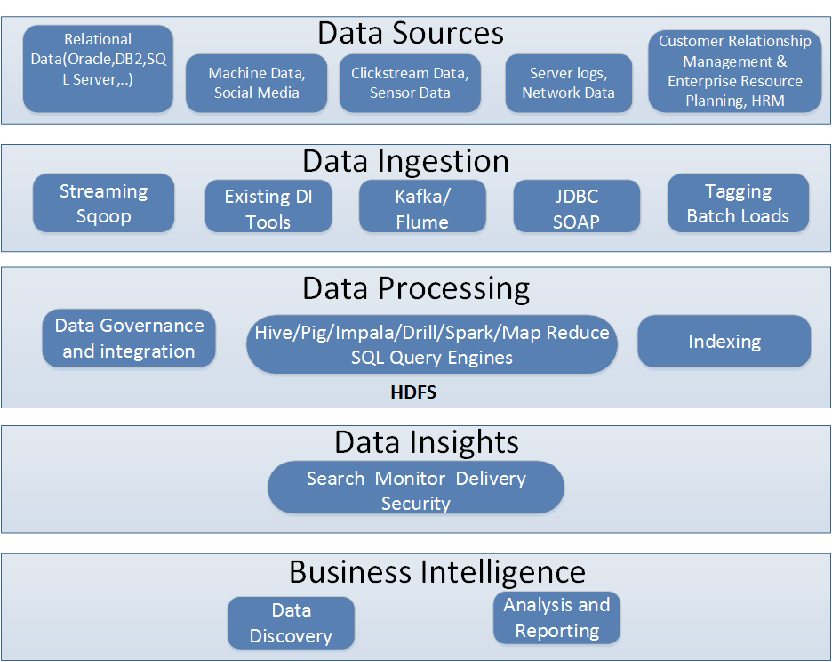
Big Data Lake Architecture

Slide 10
History
2003.2 First MapReduce library written at Google
2003.10 Google File System paper published
2004.12 Google MapReduce paper published
2005.7 Doug Cutting reports that Nutch now use new MapReduce implementation
2006.2 Hadoop code moves out of Nutch into new Lucene sub-project
2006.11 Google Bigtable paper published
2007.2 First HBase code drop from Mike Cafarella
2007.4 Yahoo! Running Hadoop on 1000-node cluster
2008.1 Hadoop made an Apache Top Level Project

Slide 11
Why Hadoop ?
Store anything. Hadoop stores data in its native format, exactly as it arrives at the cluster. Translating data on arrival so that it fits into a fixed data warehouse schema destroys information. Because Hadoop stores data without forcing that transformation, no information is lost. Downstream analyses run with no loss of fidelity. Of course it is always possible to digest, analyze and transform data, but Hadoop allows the data analyst to choose how and when to do that.
Control costs. Hadoop is open source software that runs on commodity hardware. That combination means that the cost per terabyte, for both storage and processing, is much lower than on older proprietary systems. As storage and analytic requirements evolve, a Hadoop installation can, too. Adding or removing storage capacity is simple. You can dedicate new hardware to a cluster incrementally, as required, and can retire nodes from one easily, too. As new analytic techniques are developed, they are easy to apply to new and existing data with MapReduce.

Slide 12
Why Hadoop ?
Proven at scale. You may not have petabytes of data that you need to analyze today. Nevertheless, you can deploy Hadoop with confidence because companies like Facebook, Yahoo! and others run very large Hadoop instances managing enormous amounts of data. When you adopt a platform for data management and analysis, you are making a commitment that you will have to live with for years. The success of the
biggest Web companies in the world demonstrates that Hadoop can grow as your
business does.

Slide 13
Characteristics
Very large files - files that are hundreds of megabytes, gigabytes,or terabytes in size.
Streaming data access - HDFS is built around the idea that the most efficient data processing pattern is a write-once, read-many-times pattern,time to read the whole dataset is more important than the latency in reading the first record
Commodity hardware - Hadoop doesn’t require expensive, highly reliable hardware to run on. It’s designed to run on clusters of commodity hardware (commonly available hardware available from multiple vendors)

Slide 14
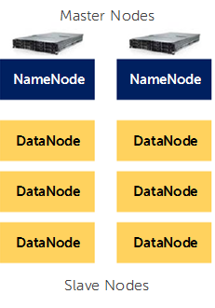
HDFS Components
A HDFS cluster has two types of node operating in a master-worker pattern:
namenode (the master)
number of datanodes (workers)

Slide 15
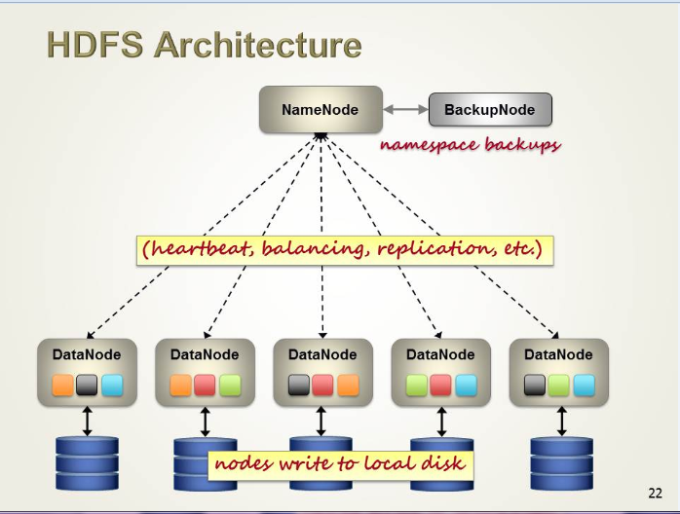
HDFS Architecture

Slide 16
Blocks
Files in HDFS are broken into block-sized chunks, which are stored as independent units.
Default is 64mb (Hadoop 1.0) and 128mb (Hadoop 2.0)
Blocks are replicated to different data nodes depending on the value of replication factor.
Block placement algorithm is rack-aware

Slide 17
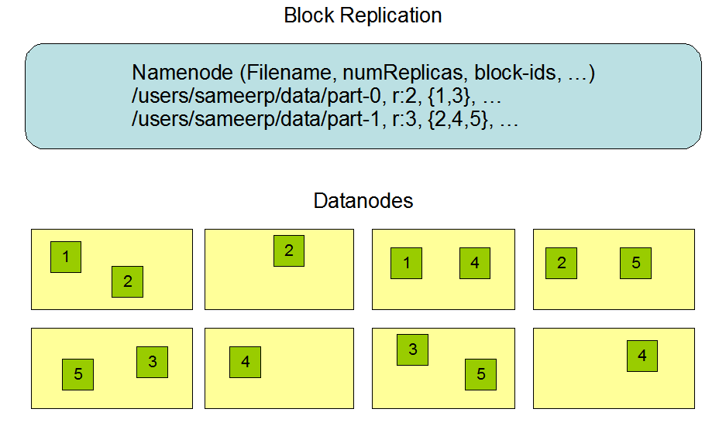
Replication Factor
Default is 3x replication.
The block size and replication factor are configured per file.

Slide 18
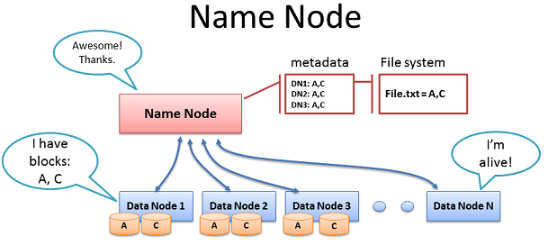
Namenode
Manages File System Namespace
Maps a file name to a set of blocks
Maps a block to the DataNodes where it resides
Cluster Configuration Management
Replication Engine for Blocks
Stores Information in memory
Each entry in the memory requires 150 byte.
This information is stored persistently on the local disk in the form of two files: the namespace image(fsimage) and the edit log.

Slide 19
Namenode Metadata
Meta-data in Memory
The entire metadata is in main memory
No demand paging of meta-data
Types of Metadata
List of files
List of Blocks for each file
List of DataNodes for each block
File attributes, e.g creation time, replication factor

Slide 20
Namenode Metadata contd…
A Transaction Log (called EditLog)
Records file creations, file deletions. Etc
FsImage
The entire namespace, mapping of blocks to files and file system properties are stored in a file called FsImage.
NameNode can be configured to maintain multiple copies of FsImage and EditLog.
Checkpoint
Occur when NameNode startup
Read FsImange and EditLog from disk and apply all transactions from the EditLog to the in-memory representation of the FsImange
Then flushes out the new version into new FsImage

Slide 21
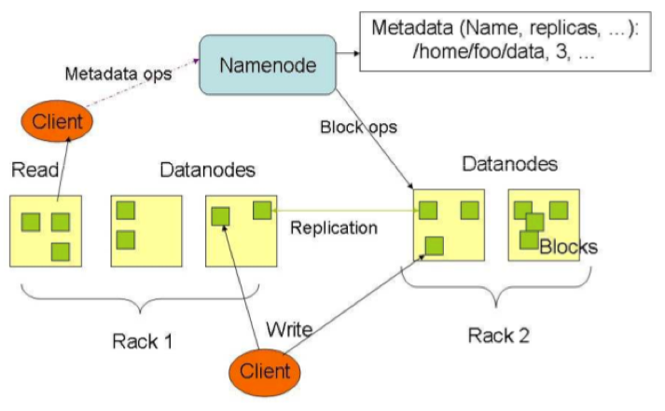
NameNode Failure
A single point of failure
Transaction Log stored in multiple directories
A directory on the local file system
A directory on a remote file system (NFS/CIFS)
Need to develop a real HA solution
SPOF!!

Slide 22
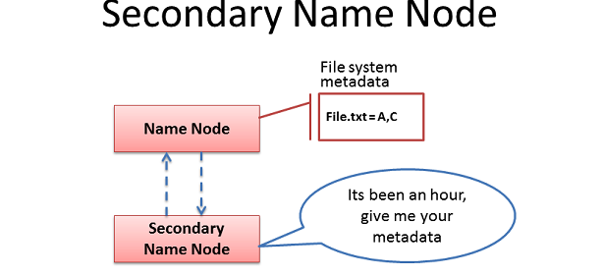
Secondary Namenode
Copies FsImage and EditLog from NameNode to a temporary directory
Merges FSImage and EditLog into a new FSImage in temporary directory.
Uploads new FSImage to the NameNode

Slide 23
Datanode
Datanodes are the work horses of the filesystem
They store and retrieve blocks when they are told to (by clients or the namenode).
Block Report
Periodically sends a report of all existing blocks to the NameNode
Facilitates Pipelining of Data
Forwards data to other specified DataNodes

Slide 24
Replica Placement
The first replica on the same node as the client (for clients running outside the cluster, a node is chosen at random, although the system tries not to pick nodes that are too full or too busy).
The second replica is placed on a different rack from the first (off-rack), chosen at random.
The third replica is placed on the same rack as the second, but on a different node chosen at random.

Slide 25
What is Hadoop used for?
Searching/ Text mining
Log processing
Recommendation systems
Business Intelligence/Data Warehousing
Video and Image analysis
Archiving
Graph creation and analysis
Pattern recognition
Risk assessment
Sentiment Analysis

Slide 26
Test Your Understanding
What is Hadoop ?
What are the components of Hadoop ?
What are the characteristic of Hadoop?
When should we use Hadoop ?
What is the role of a Datanode ?
What is the role of a Namenode ?
Compare Hadoop and Parallel DB systems

Slide 27
Summary
Hadoop is a high-performance distributed data storage and processing system.
Major components are – HDFS and Mapreduce
Hadoop was created by Doug Cutting
Hadoop became a top level Apache project in 2008
It can store any kind of data from any source, inexpensively and at very large scale, and it can do very sophisticated analysis of that data easily and quickly.
Hadoop automatically detects and recovers from hardware, software and system failures.
Hadoop provides scalable, reliable and fault tolerant services for data storage and analysis at very low cost.
HDFS is built around the idea that the most efficient data processing pattern is a write-once, read-many-times pattern.
Hadoop is not meant for real time processing.
Namenode is the central repository for metadata.
Datanodes are workhorses of the framework.

Slide 28
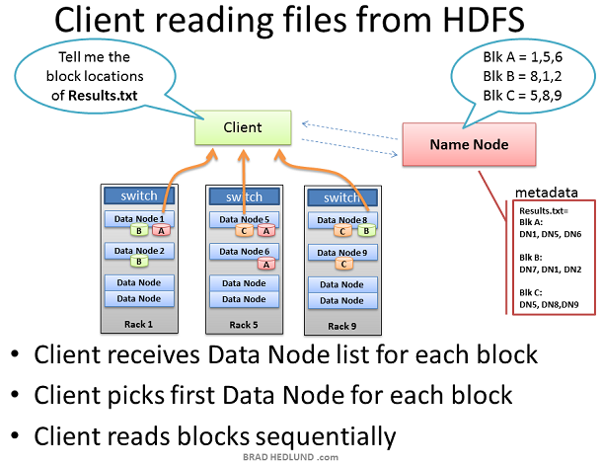
Client reading from HDFS

Slide 29
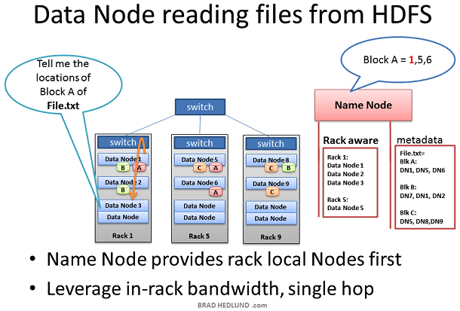
Datanode reading from HDFS

Slide 30
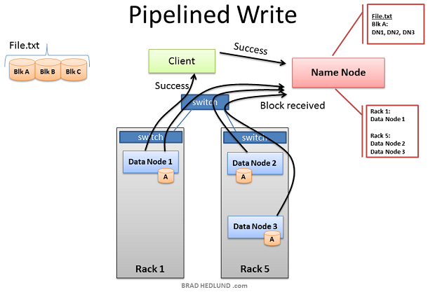
Client writing to Datanode

Slide 31
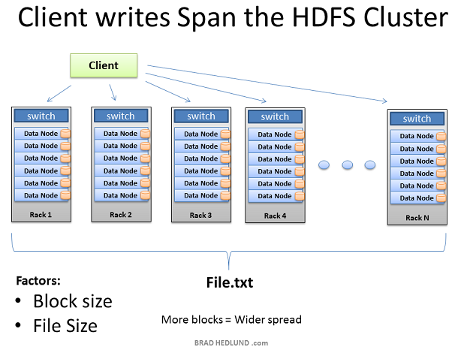
Anatomy of file write

Slide 32
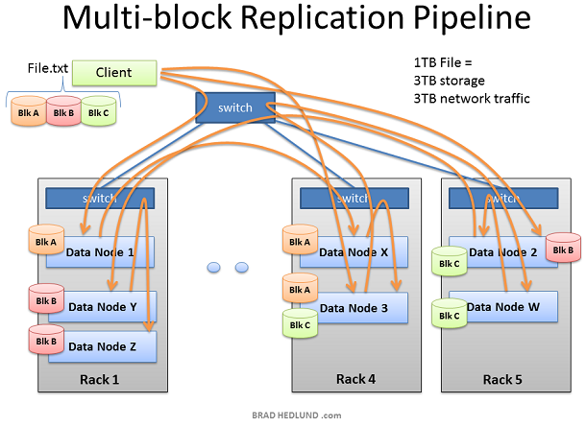
Multi Node Replication

Slide 33
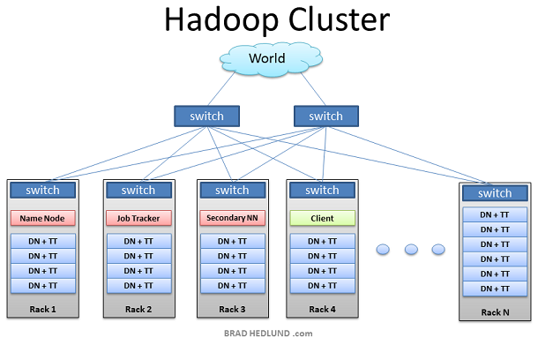
Hadoop Cluster

Slide 34
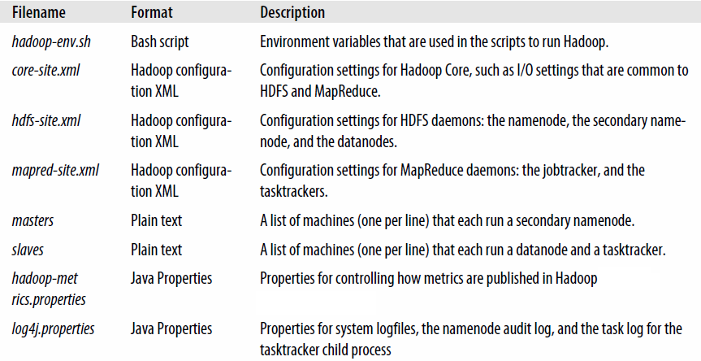
Configuration Scripts

Slide 35
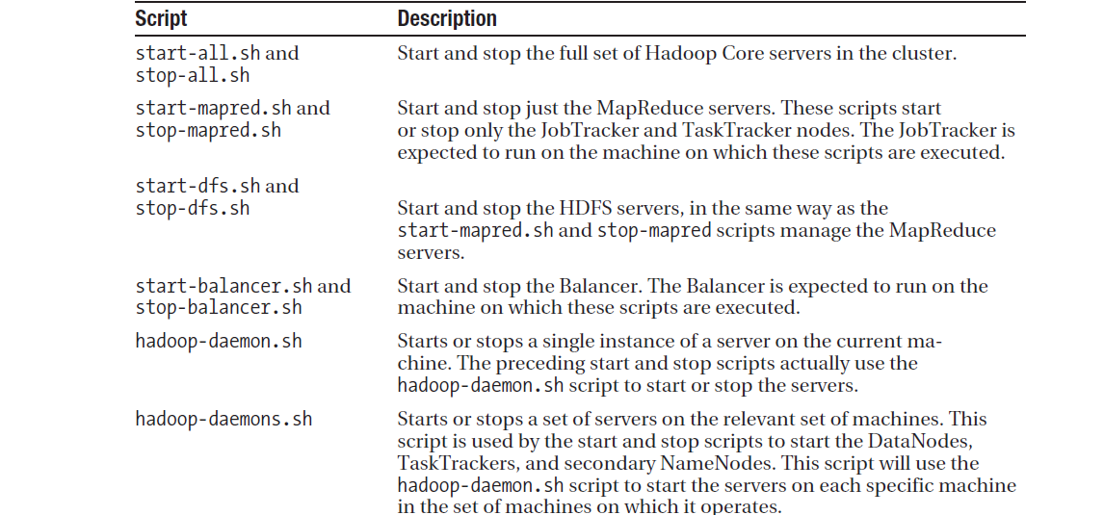
Cluster Administration Scripts

Slide 36
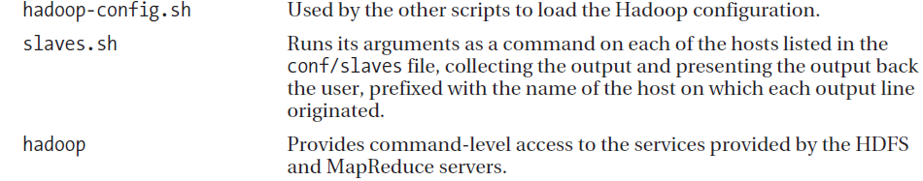
Cluster Administration Scripts

Slide 37
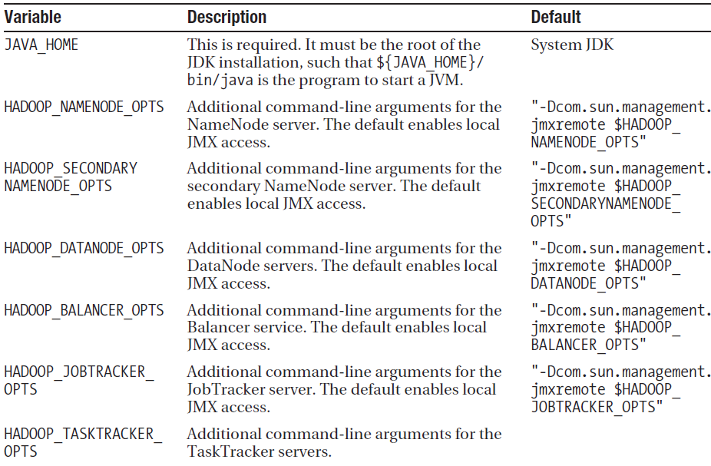
Hadoop Environment variables

Slide 38
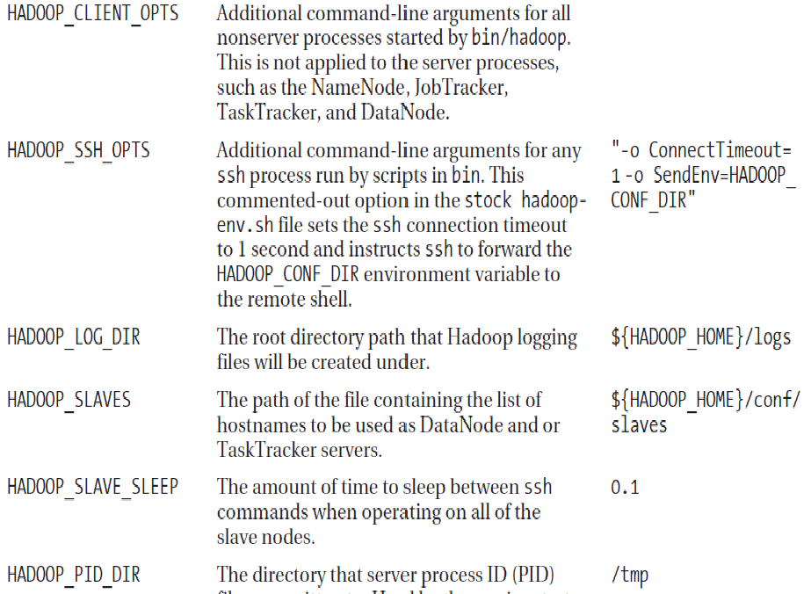
Hadoop Environment variables

Slide 39
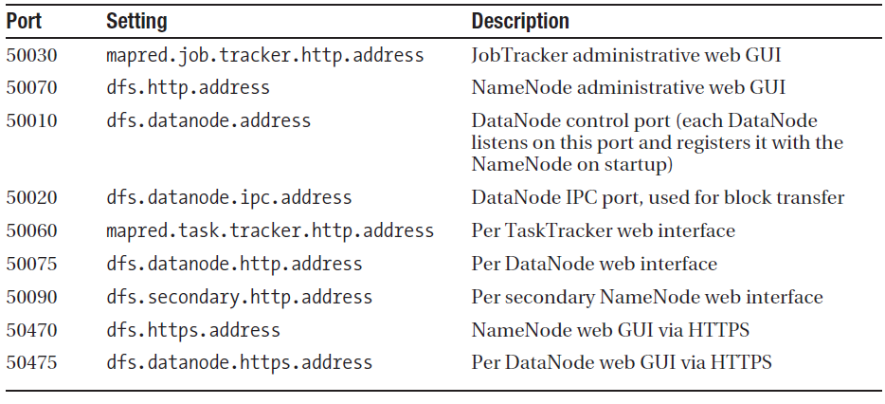
Default ports used

Slide 40
Hadoop Core configuration
Hadoop Core configuration: The Hadoop Core is configured by two XML files:
Hadoop-default.xml and hadoop-site.xml. hadoop-default.xml provides reasonable
defaults and comes with the Hadoop distribution. The configuration provided by this
default file is suitable for a single machine instance.
Hadoop-site.xml is where cluster-specific information is specified by the cluster administrator.

Slide 41
Slaves and masters
Slaves and masters:Two files are used by the startup and shutdown commands.
The slaves file contains a list of hosts, one per line, that are to host DataNode and TaskTracker servers. The masters file contains a list of hosts,one per line, that are to host secondary NameNode servers

Slide 42
Per-process runtime environment
Per-process runtime environment: The file hadoop-env.sh is responsible for tailoring the per-process environment. In particular, it includes the JAVA_HOME variable , which provides the JVM installation location.
This file also offers a way to provide custom parameters for each of the servers. Hadoop-env.sh is sourced by all of the Hadoop Core scripts provided in the conf directory of the installation

Slide 43
Reporting
Hadoop Core may be configured to report detailed information about the activities on the cluster
The file hadoop-metrics.properties controls the reporting. The default is to not report.

Slide 44
Hadoop Core Server Configuration
The hadoop-default.xml file defines more than 150 parameters, divided into six groups:
Global properties
Logging Properties
I/O Properties File System properties
Mapreduce Properties
IPC properties

Slide 45
Critical Properties
fs.defult.name – If it is not configured, there is no shared file system. The URI specified here informs the Hadoop Core framework of the default file system. The default value is file:///, which instructs the framework to use the local file system.
hadoop.tmp.dir – If it is not configured, data loss will occur. It informs the framework of the directory to use for all Hadoop Core server data storage.
mapred.job.tracker - The mapred.job.tracker parameter is critical to configure. If it is not configured, only a single machine will be used for task execution The URI specified in this parameter informs the Hadoop Core framework of the JobTracker’s location. The default value is local, which indicates that no JobTracker server is to be run, and all tasks will be run from a single JVM.

Slide 46
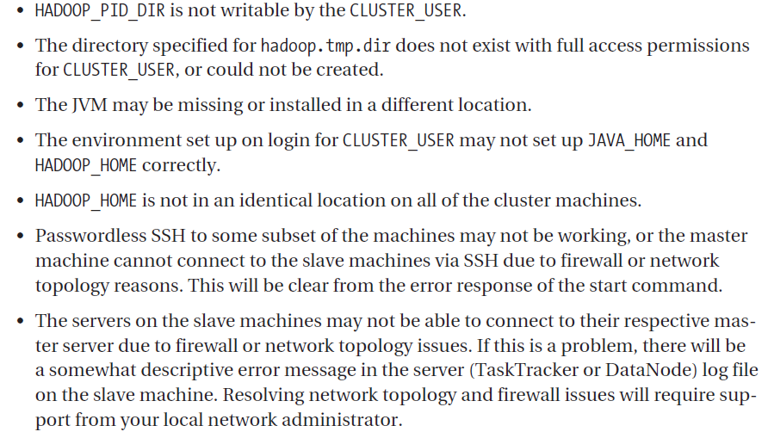
Common errors in setup

Slide 47
Namenode Recovery
Shut down the secondary NameNode.
2. Copy the contents of the secondary:fs.checkpoint.dir to the Namenode:dfs.name.dir.
3. Copy the contents of the secondary:fs.checkpoint.edits to the Namenode:dfs.name.edits.dir
4. When the copy completes, start the NameNode and restart the secondary NameNode

Slide 48
DataNode Recovery and Addition
The procedure for adding a new DataNode to a cluster and restarting a failed DataNode are identical.
The server process just needs to be started, assuming the configuration is correct, and the NameNode will integrate the new server or reintegrate a restarted server into the cluster.
The command hadoop-daemon.sh start datanode will start a DataNode server on a machine, if one is not already running

Slide 49
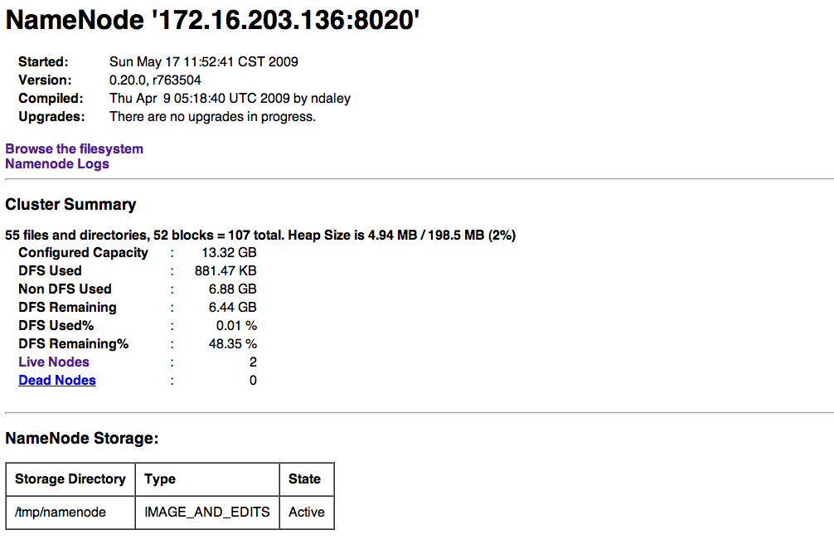
Web Interface
The NameNode web interface will be available via HTTP on port 50070 http://master:50070

Slide 50
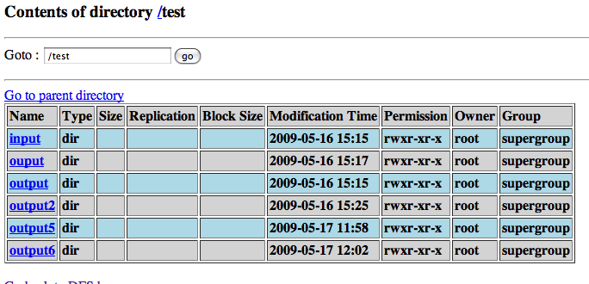
Web Interface

Slide 51
Usage Pattern
ETL
Put large data source (eg. Log files) onto the Hadoop File System
Perform aggregations, transformations, normalizations on the data
Load into RDBMS / data mart
Reporting and Analytics
Run canned and ad-hoc queries over large data
Run analytics and data mining operations on large data
Produce reports for end-user consumption or loading into data mart
Data Processing Pipelines
Multi-step pipelines for data processing
Coordination, scheduling, data collection and publishing of feeds
SLA carrying, regularly scheduled jobs

Slide 52
Usage Pattern
Machine Learning & Graph Algorithms
Traverse large graphs and data sets.
Implement machine learning algorithms over massive data sets
General Back-End Processing
Implement significant portions of back-end, batch oriented processing on the grid
General computation framework
Simplify back-end architecture

Slide 53
Hadoop is not a good fit for…
Low-latency data access - Applications that require low-latency access to data, in the tens of milliseconds range, will not work well with HDFS.
Lots of small files - Since the namenode holds filesystem metadata in memory, the limit to the number of files in a filesystem is governed by the amount of memory on the namenode.
Multiple writers, arbitrary file modifications - Files in HDFS may be written to by a single writer. Writes are always made at the end of the file. There is no support for multiple writers, or for modifications at arbitrary offsets in the file

Slide 54
Who uses Hadoop?
Amazon/A9
Facebook
Ebay
LinkedIn
Yahoo!
RazorFish
HP
Twitter
Meebo – social Networking
Google
IBM
Joost - Videos
Last.fm - Music
New York Times

Slide 55
Workshop
Workshop would include:
Walkthrough of all HDFS related process scripts
HDFS commands

Slide 56
Test Your Understanding
Which are the essential properties for a cluster setup?
What does a master file do?
What does a slave file do?
In which areas is Hadoop not a good fit?
Where can hadoop be used?

Slide 57
Summary
Hadoop cluster can be setup in three modes
Standalone
Pseudo distributed
Fully distributed
Hadoop can not recover from Namenode failure automatically.
Hadoop can recover from Data node failure.
Hadoop can be used for ETL , Reporting and Analytics, Data Processing Pipelines, machine Learning, graph Algorithms, General Back-End Processing.
Hadoop is not a good fit for Low-latency data access , Lots of small files, Multiple writers, arbitrary file modifications.

Slide 58
Big Data
You have successfully completed –
Hadoop Basics Course

